Slide 1

DIGITAL FORENSICS
DR. NILAKSHI JAIN
Email ID: nilakshijain1986@gmail.com

Slide 2
Report Writing
9.1 Goals of Report
9.2 Layout of an Investigative Report
9.3 Guidelines for Writing a Report
9.4 Sample for Writing a Report
CHAPTER NINE

Slide 3
9.1 Goals of Report
9.2 Layout of an Investigative Report
9.3 Guidelines for Writing a Report
9.4 Sample for Writing a Report
Goals of Report :
Your computer forensic reports should achieve the following goals :
1. Accurately describe the details of an incident.
2. Be understandable to decision makers.
3. Be able to withstand a barrage of legal scrutiny.
4. Be unambiguous and not open to misinterpretation.
5. Be easily referenced (using paragraph numbers for the report and Bates’ numbers for attached documents).
6. Contain all information required to explain your conclusions.
7. Offer valid conclusions, opinions, or recommendations when needed.
8. Report should be ready in time.

Slide 4
9.1 Goals of Report
9.2 Layout of an Investigative Report
9.3 Guidelines for Writing a Report
9.4 Sample for Writing a Report
Layout of an Investigative Report :
1. Executive summary: The contextual information of the state of affairs that brought about the essential for an investigation is the “executive summary” unit.
2. Objectives: Sometimes, there could be a sudden requirement to perform hard drive forensic examination. The goals of your forensic examination can be related to virtually any subject, since any type of case/action can take place.
3. Computer evidence analyzed: The detailed information regarding the assignment of evidence tag numbers and media serial numbers, as well as descriptions of the evidence, is provided in this section.
4. Relevant findings: Summary of the findings of probative value is provided in this section. It answers the question, “What relevant items were found during the investigation?” The relevant findings should
be listed in order of importance, or relevance to the case.
5. Supporting details: An in-depth look and analysis of the relative findings is provided in this section. It outlines how we found or arrived at the conclusions outlined in the “Relative Findings” section.

Slide 5
9.1 Goals of Report
9.2 Layout of an Investigative Report
9.3 Guidelines for Writing a Report
9.4 Sample for Writing a Report
Layout of an Investigative Report :
6. Investigative leads: In this section, we outline action items that could be performed to discover additional information pertinent to the investigation. If more time or additional resources were provided to the examiner or investigator, these are the outstanding tasks that could be completed.
7. Additional report subsections: In our computer forensic reports, there are several additional subsections that we often include. We have found the following subsections to be useful in specific cases, but not every case. It depends on the needs and wants of the end consumer.

Slide 6
9.1 Goals of Report
9.2 Layout of an Investigative Report
9.3 Guidelines for Writing a Report
9.4 Sample for Writing a Report
Guidelines for Writing a Report :
Following points are to be considered for writing a report:
1. Document investigative steps immediately and clearly:
Through our experience of writing a vast number of forensic reports, we have developed some report writing guidelines.
2. Know the goals of your analysis:
Before you begin your analysis for examination, know what the goals are. Every crime has elements of proof, for law enforcement examiners.
3. Organize your report:
Write “macro to micro.” Organize your forensic report to start at the high level and have the complexity of your report increase as your audience continues to read it.
4. Follow a template:
A standardized report template should be followed. This makes your report writing scalable, establishes a repeatable standard, and saves time.
5. Use consistent identifier:
There can be confusion created in a report by referring to an item in different ways, such as referring to the same computer as a system, PC, box, web server, victim system, and so on.

Slide 7
9.1 Goals of Report
9.2 Layout of an Investigative Report
9.3 Guidelines for Writing a Report
9.4 Sample for Writing a Report
Guidelines for Writing a Report :
6. Use attachments and appendices:
To maintain the flow of your report, use attachments or appendices. Right in the middle of your conclusions, you do not want to interrupt your forensic report with 15 pages of source code.
7. Have coworkers read your reports:
To read your forensic reports, employ other coworkers. This helps develop reports that are comprehensible to nontechnical personnel, who have an impact on your incident response strategy and resolution.
8. Use MD5 hashes:
Whether it is an entire hard drive or specific files, create and record the MD5 hashes of your proof. Performing MD5 hashes for all evidence provides support to the claim that you are diligent and attentive to the special requirements of forensic examination.
9. Include metadata:
Record and include the metadata for every file or file fragment cited in your report. This metadata includes the time/date stamps, full path of the file, the file size, and the file’s MD5 sum.

Slide 8
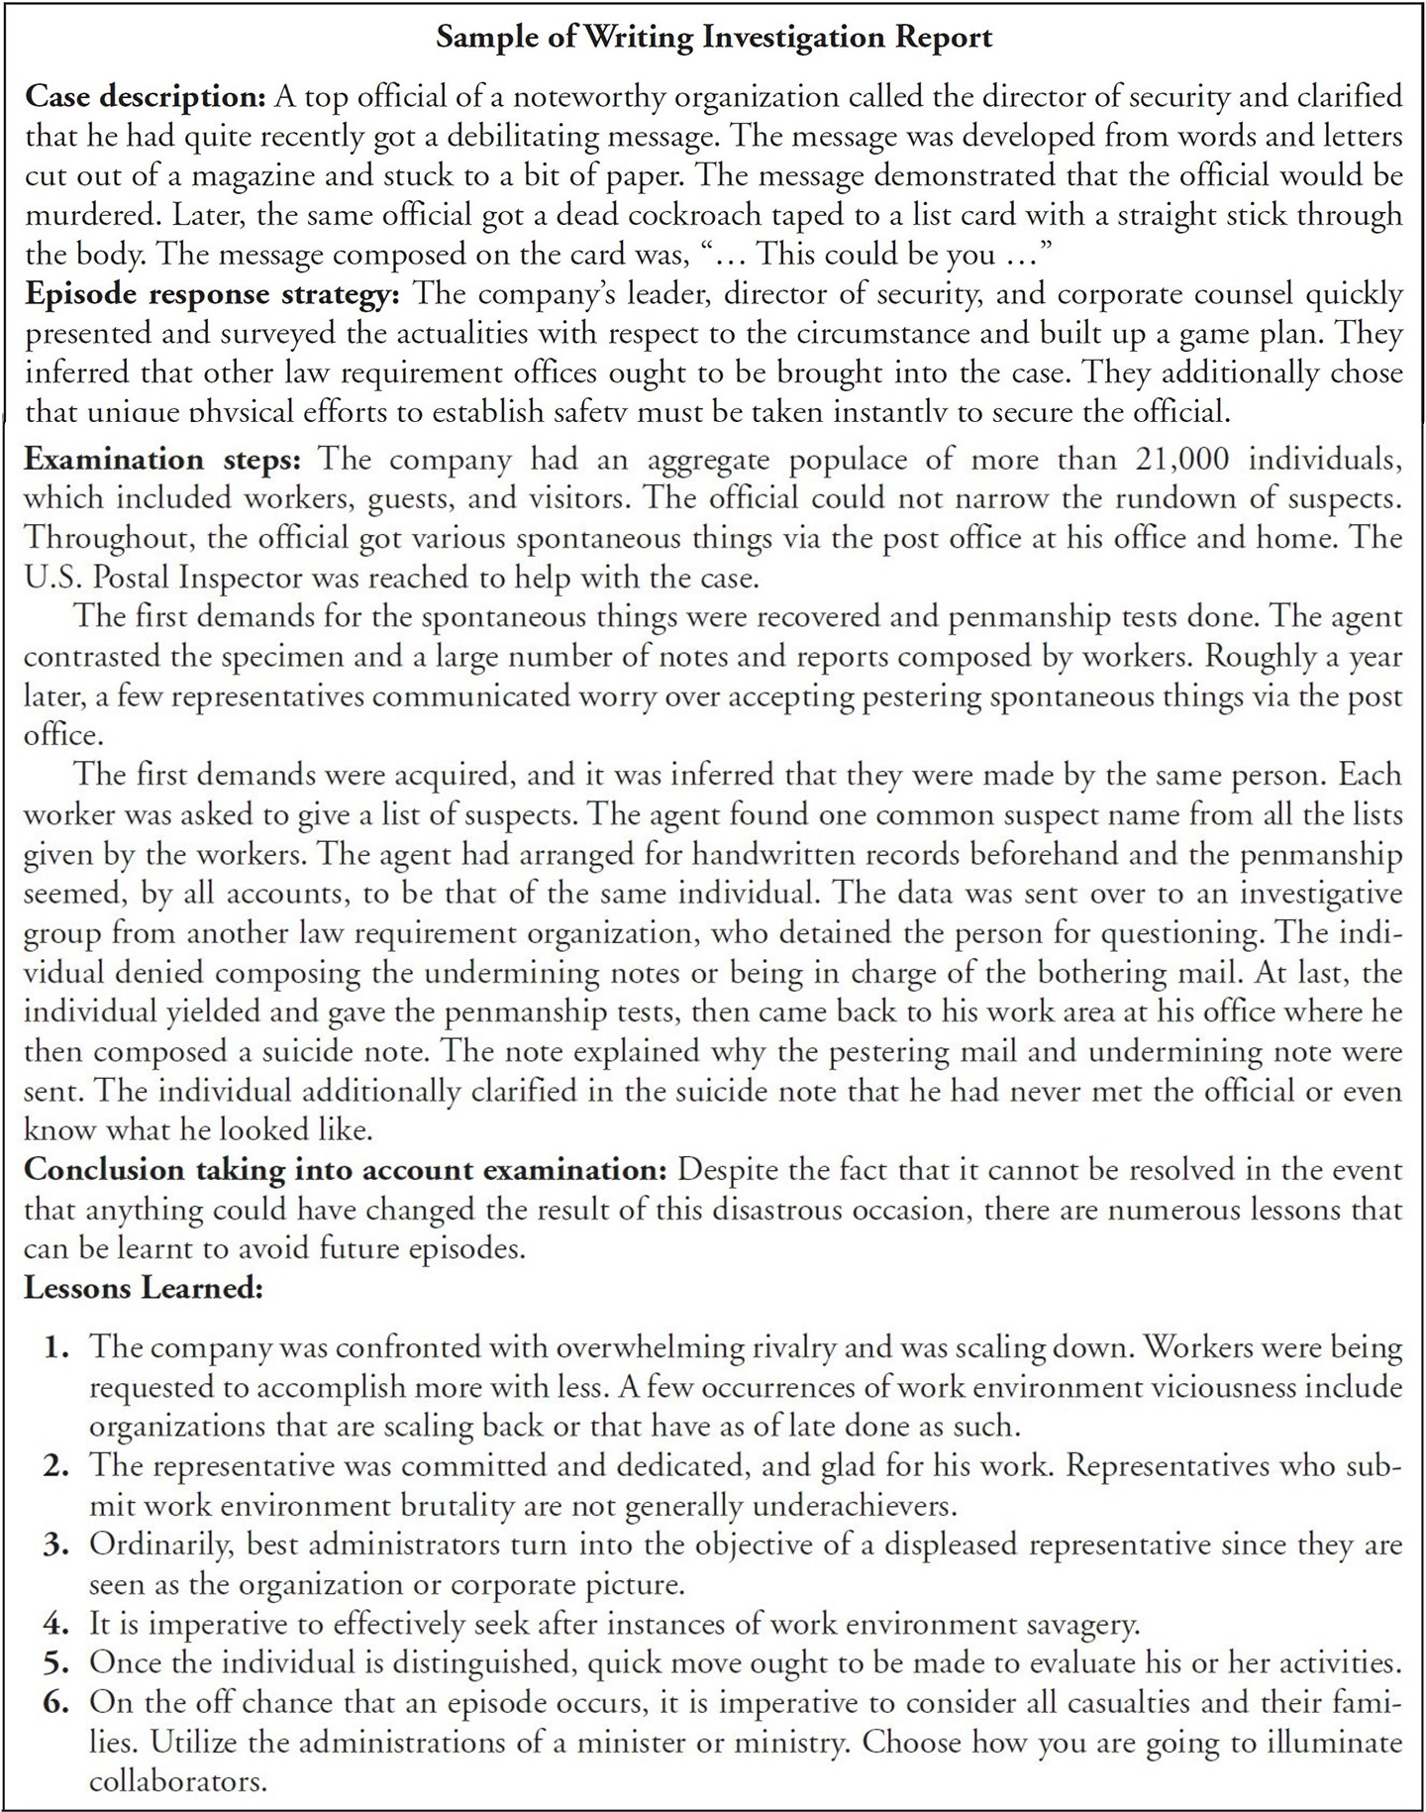
9.1 Goals of Report
9.2 Layout of an Investigative Report
9.3 Guidelines for Writing a Report
9.4 Sample for Writing a Report
Guidelines for Writing a Report :
The following example is based on sample report writing which explains about investigation steps, experience and procedure used.

Slide 9
Dr. Nilakshi Jain
Thank you
Email ID : nilakshijain1986@gmail.com

